Slide 1


A Major Project Title
IMPROVED STUDENT PORTAL
GUIDED BY: SUBMITTED BY:ASST.Prof. ANJALI SAH NAMRISHA GUPTA
ANIRUDH BHARDWAJ

Slide 2
INTRODUCTION
IMPROVED STUDENT PORTAL, deals with the maintenance of university, college, faculty, student information with in the university. UMS is an automation system, which is used to store the college, faculty, student, courses and information of a college.
Starting from registration of a new student in the college, it maintains all the details regarding the attendance and marks of the students. The project deals with retrieval of information through an INTRANET based campus wide portal. It collects related information from all the departments of an organization and maintains files, which are used to generate reports in various forms to measure individual and overall performance of the students.

Slide 3
PROPOSED SYSTEM
IMPROVED STUDENT PORTAL, makes management to get the most updated information always by avoiding manual accounting process. This system has the following functional divisions.
University Administrator
College Administrator
User (Students / Faculties)

Slide 4
EXISTING SYSTEM
The system starts with registration of new staff and students. When the subjects are to be allocated to the faculty, the Head of the Department should enter everything in the Excel sheets. Then the staff enters corresponding subject’s attendance and marks of a student then those must also be entered in the Excel sheets and validations are to be done by the user itself. So there will be a lot of work to be done and must be more conscious during the entrance of details. So, more risk is involved.

Slide 5
PROJECT REQUIREMENT
S/w and H/w requirements
1.Environment:
* Servers:
* Operating System Server: - Microsoft Windows 2000
or Higher
* Data Base Server: Microsoft SQL Server 2000/2005
* Clients : Microsoft Internet Explorer,
* Tools : Microsoft Visual Studio .Net
* User Interface: ASP.NET with AJAX
* Code Behind : VC#.NET

Slide 6
PROJECT REQUIREMENT
2. Requirements:
Hardware requirements:
Number Description
1. PC with 2 GB hard-disk
and 256 MB RAM
Software requirements:
Number Description
1. Windows 2000/ XP/ or Higher with MS- office
2. MS-SQL server2000/2005
3. Ms-Visual Studio .Net 2005
4. Ms-Internet Explorer

Slide 7
PROBLEMS IN THE EXISTING SYSTEM
Storing and accessing the data in the form of Excel sheets and account books is a tedious work. It requires a lot of laborious work. It may often yield undesired results. Maintaining these records as piles may turn out to be a costlier task than any other of the colleges and institutions

Slide 8
RISKS INVOLVED IN EXISTIN SYSTEM
Present System is time-consuming and also results in lack of getting inefficient results.
Some of the risks involved in the present system are:
During the entrance of marks and attendance, if any mistake is done at a point, then this becomes cumulative and leads to adverse consequences.
If there is any need to retrieve results it may seem to be difficult to search.

Slide 9
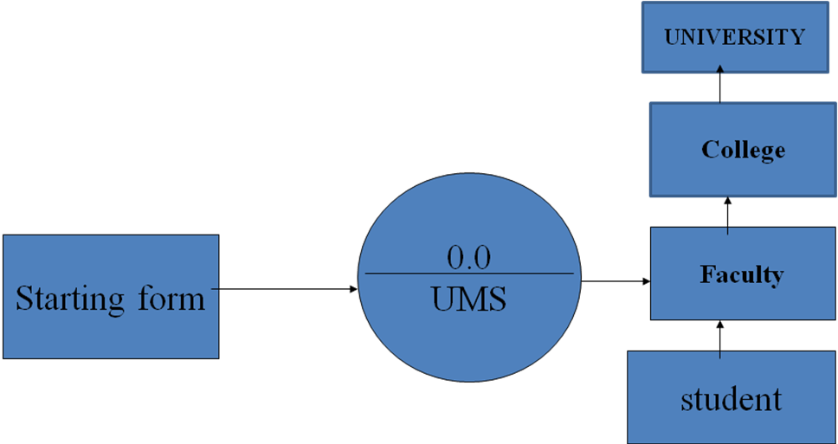
DATA FLOW DIAGRAM

Slide 10
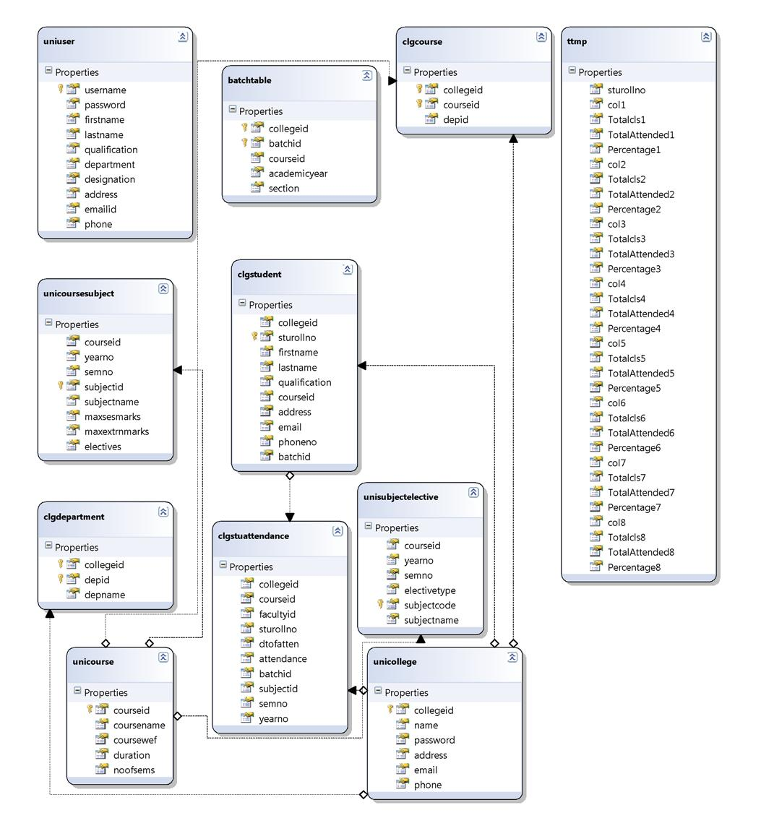
ER DIAGRAM

Slide 11
USECASE DIAGRAMS
Use Case Diagram for University Admin

Slide 12
USECASE DIAGRAMS
Use Case Diagram for Student

Slide 13
ADVANTAGES
1. It’s a web-enabled project. This project offers user to enter the data through simple and interactive forms. This is very helpful for the client to enter the desired information through so much simplicity.
2.The user is mainly more concerned about the validity of the data, whatever he is entering. There are checks on every stages of any new creation, data entry or updation so that the user cannot enter the invalid data, which can create problems at later date.
3.Sometimes the user finds in the later stages of using project that he needs to update some of the information that he entered earlier. There are options for him by which he can update the records. Moreover there is restriction for his that he cannot change the primary data field. This keeps the validity of the data to longer extent.
4.User is provided the option of monitoring the records he entered earlier. He can see the desired records with the variety of options provided by him.

Slide 14
ADVANTAGES
5. From every part of the project the user is provided with the links through framing so that he can go from one option of the project to other as per the requirement. This is bound to be simple and very friendly as per the user is concerned. That is, we can sat that the project is user friendly which is one of the primary concerns of any good project.
6. Data storage and retrieval will become faster and easier to maintain because data is stored in a systematic manner and in a single database.
7. Decision making process would be greatly enhanced because of faster processing of information since data collection from information available on computer takes much less time then manual system.
8.Allocating of sample results becomes much faster because at a time the user can see the records of last years.

Slide 15
ADVANTAGES
9.Easier and faster data transfer through latest technology associated with the computer and communication.
10. Through these features it will increase the efficiency, accuracy and transparency

Slide 16
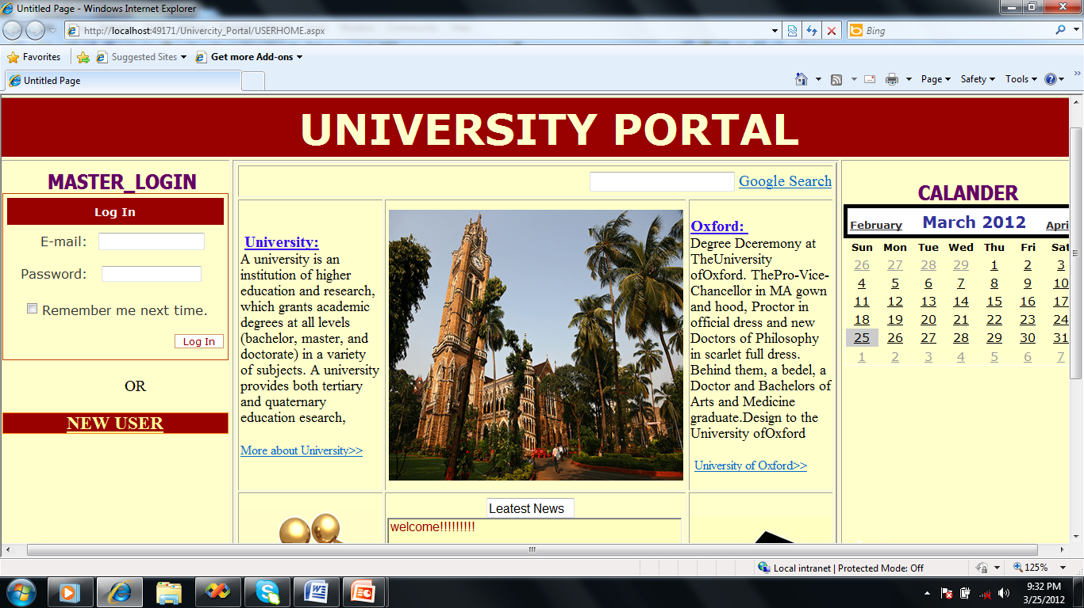
SCREEN SHOTS
IMPROVED STUDENT PORTAL

Slide 17
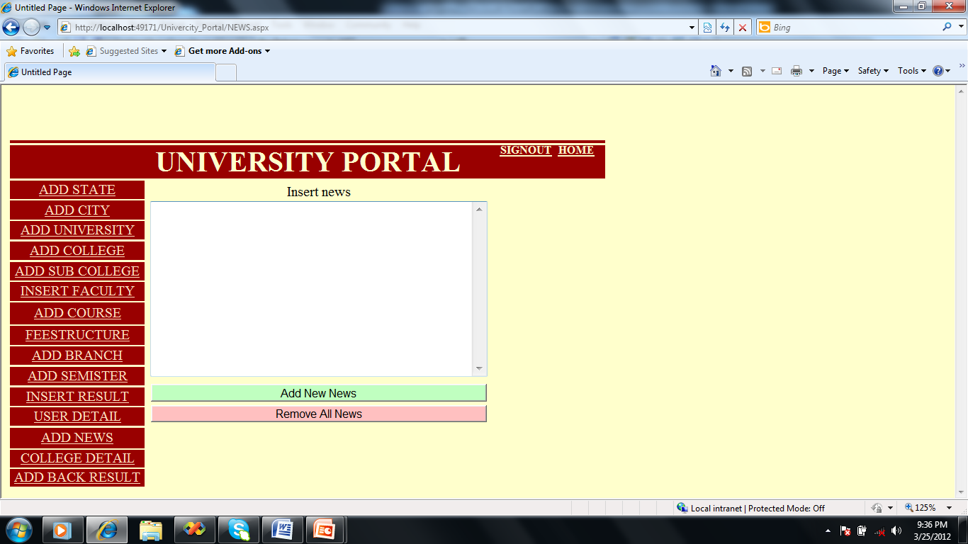
SCREEN SHOTS
IMPROVED STUDENT PORTAL

Slide 18
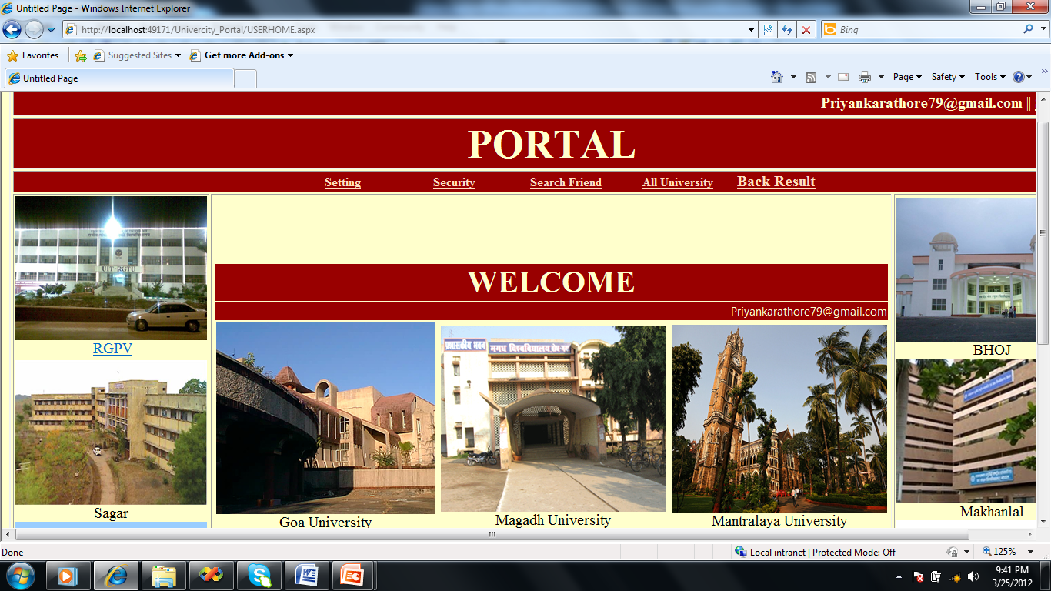
SCREEN SHOTS
er.himanshu.yadav24@gmail.com

Slide 19
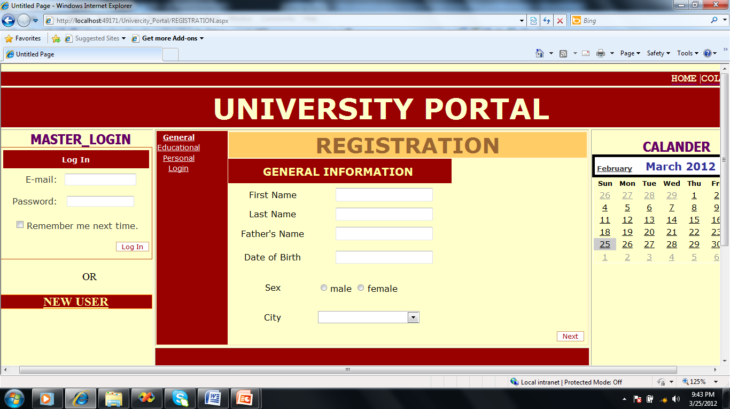
SCREEN SHOTS
IMPROVED STUDENT PORTAL

Slide 20
SCREEN SHOTS

Slide 21
LIMITATIONS:
1. The size of the database increases day-by-day, increasing the load on the database back up and data maintenance activity.
2. Training for simple computer operations is necessary for the users working on the system.

Slide 22
FUTURE IMPROVEMENT
1. It can be implemented to upload files with an huge amount of size with the support of various file formats.
2. This System being web-based and an undertaking of Cyber Security Division, needs to be thoroughly tested to find out any security gaps.
3. A console for the data centre may be made available to allow the personnel to monitor on the sites which were cleared for hosting during a particular period.
4. Moreover, it is just a beginning; further the system may be utilized in various other types of auditing operation viz. Network auditing or similar process/workflow based applications...

Slide 23
THANK YOU

